Slide 1
Data Pipeline using Snowflake
By – Varun Jain

Slide 2
Agenda
Create real world batch/streaming ingestion using AWS native services
Configure ingestion pipeline using AWS managed Airflow(MWAA)
Perform ingestion and transformation in Snowflake
Drawbacks of Snow Pipe and its alternative
Role Management and security in Snowflake
Troubleshooting Dag in Airflow

Slide 3

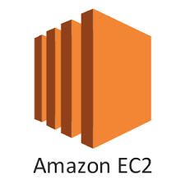
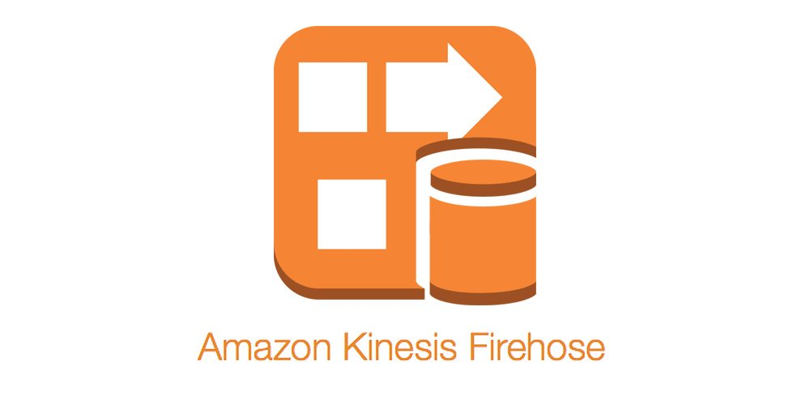


Data sent to Firehose
S3 Landing
Kinesis Agent
DAG trigger
Streaming Data
S3 processing
S3 processed
Triggered Loading Data in Snowflake & Transformation on Data

Slide 4
Creation of Data Pipeline using AWS Native Services

Slide 5
AWS Service Used
IAM
S3
EC2
Kinesis Firehose
Cloud Watch
Kinesis Agent
AWS Managed Airflow (MWAA)

Slide 6
AWS S3

Slide 7
S3 – Basics
Amazon S3 is easy to use, with a simple web services interface to store and retrieve any amount of data from anywhere on the web.
S3 is safe place to store files
The data is spread across multiple devices and facilities
S3 is object based i.e., allows you to upload files.
File size can be from 0 bytes to 5 TB.
There is unlimited storage
Files are stored in buckets.

Slide 8
S3 – Basics
S3 bucket has universal namespace, that is, names must be unique globally.
When you upload a file to S3 you will receive a HTTP 200 code if the upload was successful.

Slide 9
S3 – Features
Durability and availability
Tiered Storage Available
Lifecycle Management
Versioning
Encryption
Secure your data using Access control Lists and Bucket Policies

Slide 10
Video Lab - Creation of S3 Bucket

Slide 11
AWS – Identity and Access Management (IAM)

Slide 12
AWS IAM
AWS Identity and Access Management (IAM) enables you to manage access to AWS services and resources securely.
Using IAM, you can create and manage AWS users and groups, and use permissions to allow and deny their access to AWS resources.
IAM is a feature of your AWS account offered at no additional charge.
Use Case
Fine-grained access control to AWS resources
Multi-factor authentication for highly privileged users
Analyze access
Integrate with your corporate directory

Slide 13
IAM Policy
IAM policies specify which services/actions are allowed or denied
Policies are attached to group, users, and roles, which are then subject to permissions that you define.
Policies can be granted either from AWS API programmatically or the AWS management console.

Slide 14
IAM Roles
IAM role is an IAM identity that you can create in your account that has specific permissions.
Roles are not uniquely associated with one person, a role is intended to be assumable by anyone who needs it.
You can use roles to delegate access to users, applications, or services that don't normally have access to your AWS resources.

Slide 15
Video Lab – Creation of IAM Policy and Role

Slide 16
AWS EC2

Slide 17
AWS EC2
Provides resizable compute capacity in the cloud
Designed to make web-scale cloud computing easier
A true virtual computing environment
Launch instances with a variety of operating systems
Run as many or few systems as you desire
Features
Completely controlled
Flexible
Elastic
Web-scale
Easy to Start
Reliable
Inexpensive
Secure

Slide 18
Video Lab – Creation of EC2 instance and ssh to EC2 instance using putty

Slide 19
AWS Kinesis Firehose

Slide 20
AWS Kinesis Firehose
Delivery Stream – The underlying entity of firehose. Use firehose by creating a delivery stream to a specified destination and send data to it.
Record – The data of interest that your data producer sends to a delivery stream. A record can be large as 1000 KB.
Data Producers – Producers send records to a Delivery stream. For example, a web server sends log data to a delivery stream is a data producer.

Slide 21
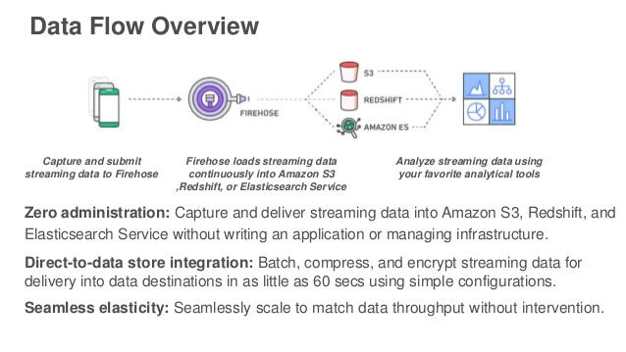

Slide 22
Video Lab – Creation of Kinesis Firehose Delivery

Slide 23
Video Lab Configuring Kinesis Firehose delivery with all the required S3 and parameters

Slide 24
AWS Cloud Watch

Slide 25
What is Cloud Watch
Amazon CloudWatch monitors your Amazon Web Services (AWS) resources and the applications you run on AWS in real time.
You can use CloudWatch to collect and track metrics, which are variables you can measure for your resources and applications.
CloudWatch alarms send notifications or automatically make changes to the resources you are monitoring based on the rules that you define.
In addition to monitoring the built-in metrics that come with AWS, you can monitor your own custom metrics.
With CloudWatch, you gain system-wide visibility into resource utilization, application performance and operational health

Slide 26
Video Lab – Installing Kinesis Agent and sending data to Firehose

Slide 27
AWS Managed Airflow (MWAA)

Slide 28
What is AWS Managed Airflow
Amazon Managed Workflows for Apache Airflow (MWAA) is a managed orchestration service for Apache Airflow
It is easier to setup and operate end-to-end data pipelines
Apache Airflow is an open-source tool used to programmatically author, schedule, and monitor sequences of processes and tasks referred to as "workflows”.
With Amazon MWAA, you can use Airflow and Python to create workflows without having to manage the underlying infrastructure for scalability, availability, and security.

